Slide 1
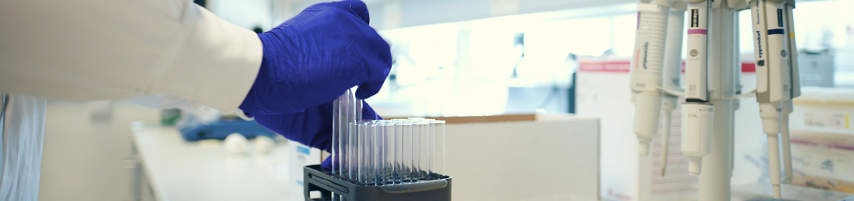
Sotorasib Plus Panitumumab and FOLFIRI for Previously Treated KRAS G12C-mutated Metastatic Colorectal Cancer (mCRC): CodeBreaK 101 Phase 1b Safety and Efficacy
Hong DS, et al. Poster presented at: American Society of Clinical Oncology; June 2–6, 2023; Chicago, IL. Poster #3513
SC-AT-CP-00500 0623
David S. Hong,¹ Yasutoshi Kuboki,² John H. Strickler, ³ Marwan Fakih, ⁴ Hélène Houssiau, ⁵ Timothy J. Price, ⁶ Elena Élez, ⁷ Salvatore Siena, ⁸ Emily Chan, ⁹ Jane Hippenmeyer, ⁹ Panli Cardona, ⁹ Qui Tran, ⁹ Toshiki Masuishi ¹⁰
¹University of Texas MD Anderson Cancer Center, Houston, TX, USA; ²National Cancer Center Hospital East, Kashiwa, Chiba, Japan; ³Duke University Medical Center, Durham, NC, USA; ⁴City of Hope Comprehensive Cancer Center, Duarte, CA, USA, ⁵Cliniques Universitaires Sain-Luc, Brussels, Belgium, ⁶Queen Elizabeth Hospital, University of Adelaide, Adelaide, Woodville, Australia; ⁷Vall d'Hebron Institute of Oncology (VHIO), Vall d'Hebron University Hospital, Barcelona, Spain, ⁸Università degli Studi di Milano, Grande Ospedale Metropolitano Niguardia, Milan, Italy; ⁹Amgen Inc., Thousand Oaks, CA, USA; ¹⁰Aichi Cancer Center Hospital, Nagoya, Japan

Slide 2
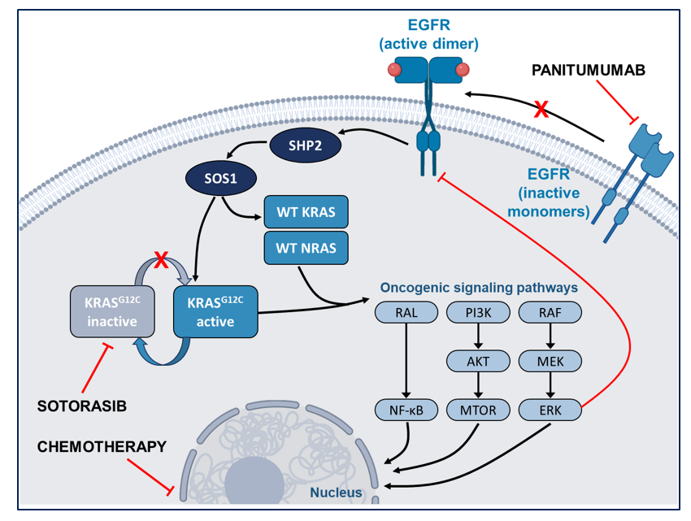
Introduction
Approximately 3% of patients with CRC have an oncogenic KRAS G12C mutation^{1,2}
Sotorasib, a KRAS^{G12C} inhibitor, combined with panitumumab, a monoclonal anti-EGFR antibody, showed an ORR of 30% in patients with KRAS G12C-mutated mCRC³
These findings suggest that sotorasib plus panitumumab mitigates sotorasib-related feedback reactivation of the RAS-MAPK pathway and accumulation of activated EGFR^{4,5}
Sotorasib plus panitumumab and FOLFIRI may further enhance sotorasib efficacy while maintaining a manageable safety profile
We present the first results for the KRASG12C inhibitor sotorasib combined with the EGFR inhibitor panitumumab and FOLFIRI chemotherapy in patients with prior mCRC treatment
ORR, objective response rate
1. Neumann J, et al. Pathol Res Pract. 2009;205:858-862. 2.Thein KZ, et al. JCO Precis Oncol. 2022;6:e2100547. 3.Kuboki Y, et al. Ann Oncol. 2022;33:S1445-1446. 4.Ryan MB, et al. Cell Rep. 2022;39:110993. 5.Amodio V, et al. Cancer Discov. 2020;10:1129-1139.
Hong DS, et al. Poster presented at: American Society of Clinical Oncology; June 2–6, 2023; Chicago, IL. Poster #3513

Slide 3
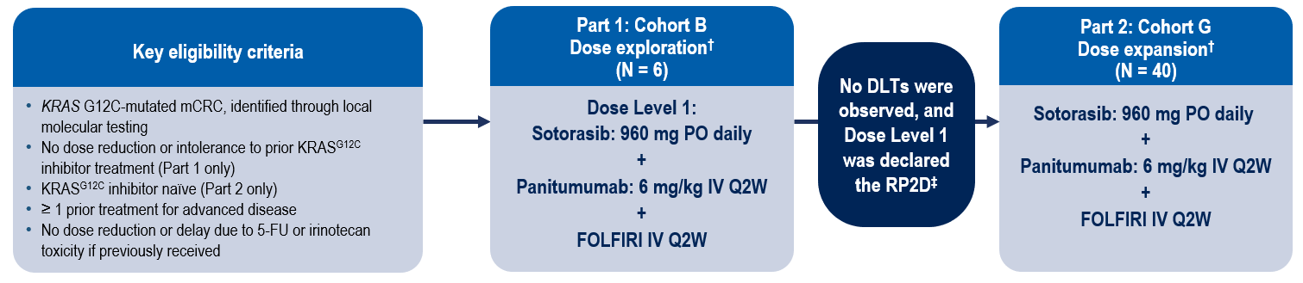
Study Design
CodeBreaK 101 Subprotocol H phase 1b, multicenter, open-label study*:
Sotorasib + Panitumumab + FOLFIRI in previously treated KRAS G12C-mutated mCRC
Primary Endpoint: Safety and tolerability
Secondary Endpoints: Anti-tumor efficacy (ORR, DCR, DOR, TTR, PFS per RECIST v1.1, and OS) and PK
*NCT04185883. †Treatment until disease progression, withdrawal of consent, or end of study. ‡No dose adjustment was needed.
5-FU, fluorouracil, DLT, dose-limiting toxicity; DOR, duration of response; fluorouracil; IV, intravenous; ORR, objective response rate; OS, overall survival PO, PK, pharmacokinetics; orally; Q2W, every 2 weeks
Hong DS, et al. Poster presented at: American Society of Clinical Oncology; June 2–6, 2023; Chicago, IL. Poster #3513

Slide 4
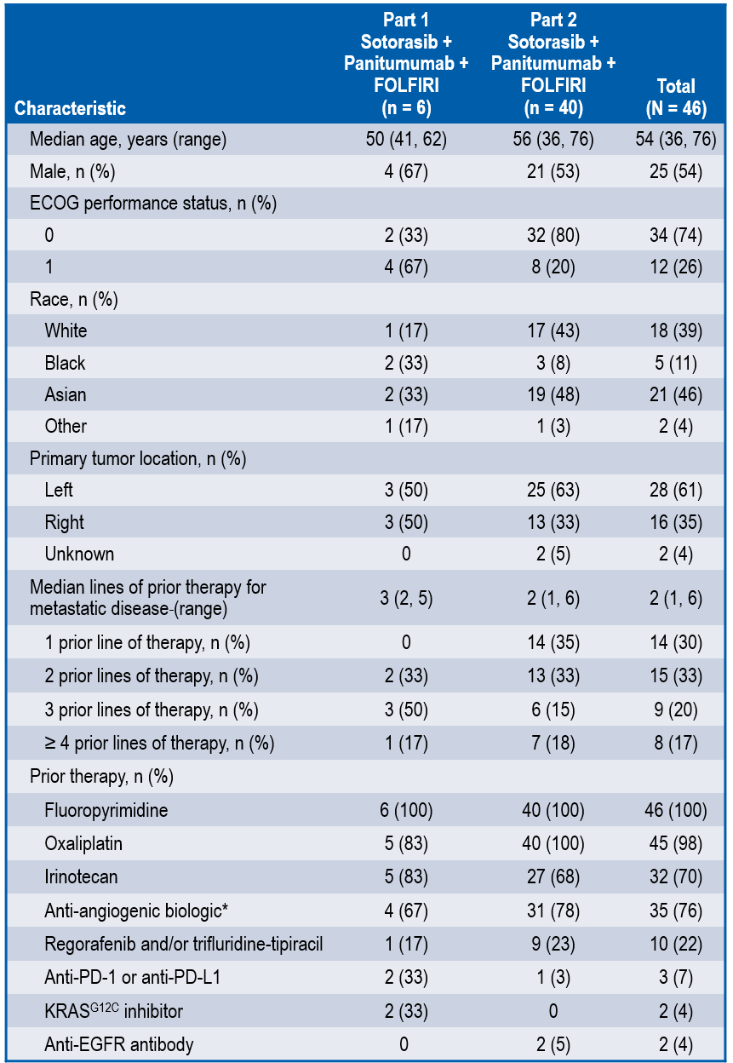
Baseline Characteristics
All patients received prior fluoropyrimidine, and 70% of patients received prior irinotecan
Patients received a median of 2 prior lines of therapy with approximately one-third each receiving the study regimen as second‑line, third-line or ≥ fourth-line therapy
*Includes bevacizumab, aflibercept, ramucirumab.
Hong DS, et al. Poster presented at: American Society of Clinical Oncology; June 2–6, 2023; Chicago, IL. Poster #3513

Slide 5
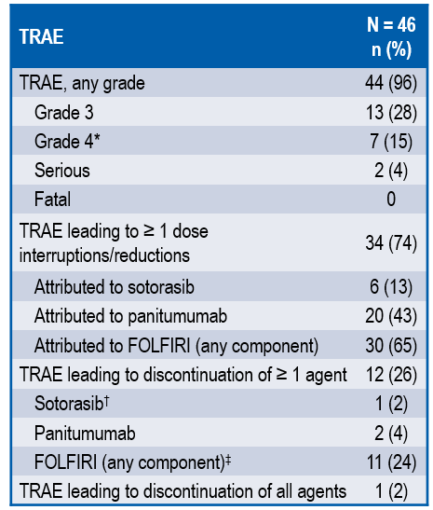
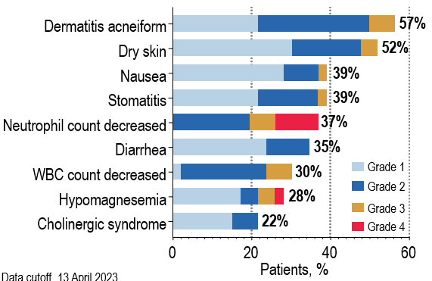
Safety
TRAEs occurring in ≥ 20% of patients (any grade)
No DLTs were observed in dose exploration and sotorasib 960 mg daily, panitumumab 6 mg/kg IV Q2W and FOLFIRI IV Q2W was determined as the RP2D
Safety findings were consistent with known profiles of sotorasib, panitumumab, and FOLFIRI
Data cutoff, 13 April 2023.
*Grade 4 TRAEs were neutrophil count decreased (n = 5, 11%), blood creatine phosphokinase increased (n = 1, 2%), and hypomagnesemia (n = 1, 2%).
†Sotorasib discontinuation was required in 1 patient due to grade 3 alanine aminotransferase increase attributed to all components of treatment.
‡The most common component discontinued due to TRAE was 5-FU, occurring in 11 (24%) of patients. Discontinuation of 5-FU bolus while continuing 5-FU continuous infusion did not count as discontinuation of one component.
DLT, dose-limiting toxicity; IV, intravenous; RP2D, recommended phase 2 dose; TRAE, treatment-related adverse event
Hong DS, et al. Poster presented at: American Society of Clinical Oncology; June 2–6, 2023; Chicago, IL. Poster #3513

Slide 6
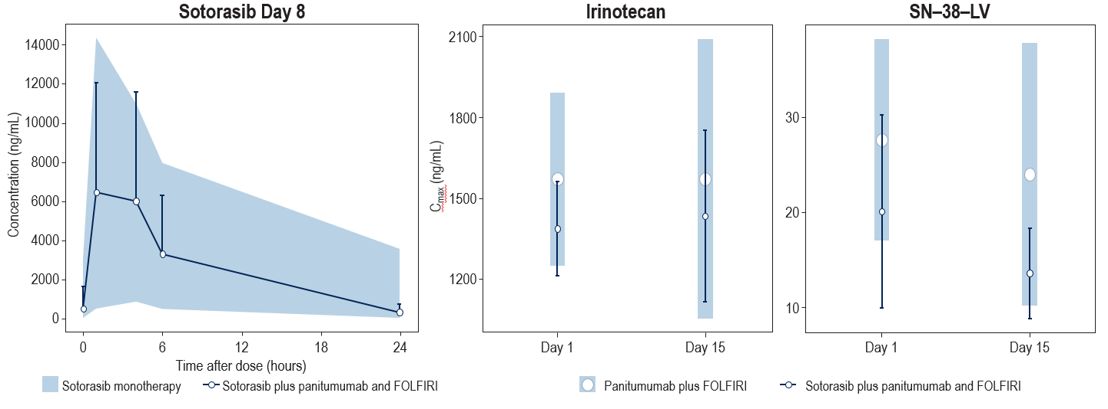
Pharmacokinetic Analysis
Plasma concentration levels of sotorasib in the study regimen of sotorasib plus panitumumab and FOLFIRI were consistent with those observed in monotherapy studies with sotorasib¹
The plasma concentration levels of irinotecan and its active metabolite SN-38 displayed mild reductions between days 1 and 15, but were still within the therapeutic range reported previously²
No clinically meaningful PK interaction was observed between sotorasib and irinotecan
Blue lines with error bars represent mean data observed + SD in this study when sotorasib was co-administered with panitumumab and FOLFIRI (n = 27). Shaded area represents 5th and 95th quantile of data observed in monotherapy study when sotorasib was given alone (n = 706). Blue circle with error bars represent the mean ± SD observed in this study when irinotecan was co-administered with sotorasib plus panitumumab and FOLFIRI (n = 9). Shaded area represents mean +/- SD of reference panitumumab and FOLFIRI (n = 19).
PK, pharmacokinetics
1. Fakih M, et al. Ann Oncol. 2021;32:S530-582. 2.Yang BB, et al. Clin Pharmacol Drug Dev. 2013;2:205-212.
Hong DS, et al. Poster presented at: American Society of Clinical Oncology; June 2–6, 2023; Chicago, IL. Poster #3513

Slide 7
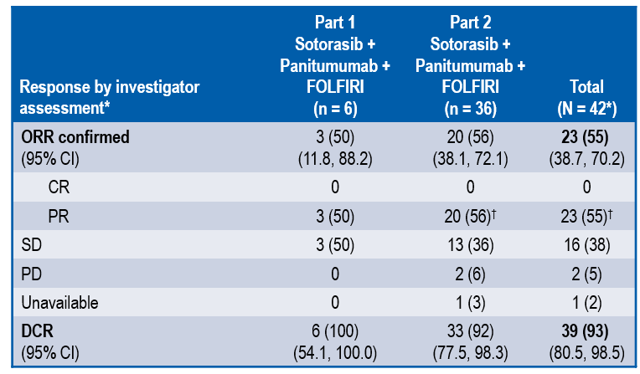
Efficacy
Confirmed ORR (all partial responses) was 55% (95% CI: 38.7, 70.2) and DCR was 93% (95%CI: 80.5, 98.5), with 2 additional patients with unconfirmed responses awaiting confirmatory scan
Data cutoff, 13 April 2023.
The 2 patients treated with prior sotorasib achieved partial response (n = 1) and stable disease (n = 1).
*42 patients enrolled at least 7 weeks before analysis cutoff were included for response summary.
†2 additional patients had unconfirmed partial responses that are awaiting confirmatory scan and not included in these numbers.
CR, complete response; DCR, disease control rate; ORR, objective response rate; PR, partial response; SD, stable disease
Hong DS, et al. Poster presented at: American Society of Clinical Oncology; June 2–6, 2023; Chicago, IL. Poster #3513

Slide 8
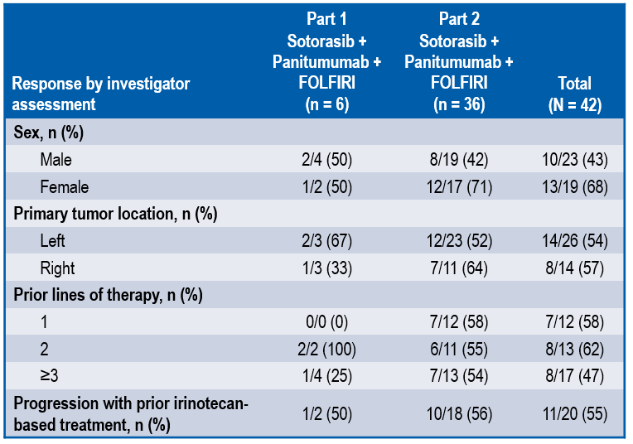
Response by Subgroup
Response to sotorasib plus panitumumab and FOLFIRI appeared to be independent of prior lines of therapy or prior progression with irinotecan-based treatments
Hong DS, et al. Poster presented at: American Society of Clinical Oncology; June 2–6, 2023; Chicago, IL. Poster #3513

Slide 9
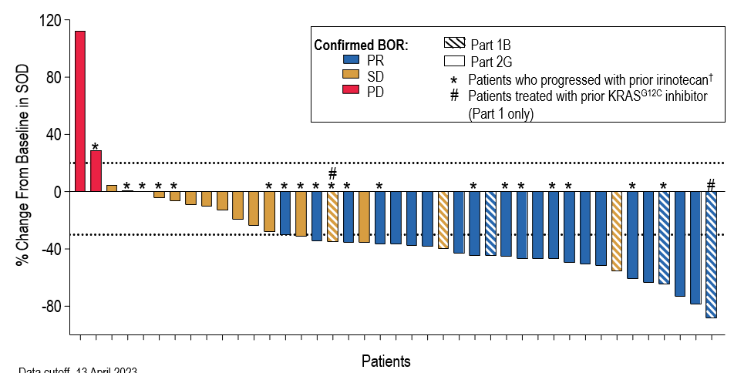
Tumor Response
Reduction in RECIST target lesions was observed in 86% of patients‡
Data cutoff, 13 April 2023.
†Patients whose disease progressed on prior irinotecan include those with clinical or radiographical progression.
‡42 patients enrolled at least 7 weeks before analysis cutoff were included for response summary; 1 patient with no post-baseline scan is not shown in figure but is included in the denominator.
PD, progressive disease; RECIST, Response Evaluation Criteria in Solid Tumors; PR, partial response; SD, stable disease
Hong DS, et al. Poster presented at: American Society of Clinical Oncology; June 2–6, 2023; Chicago, IL. Poster #3513

Slide 10
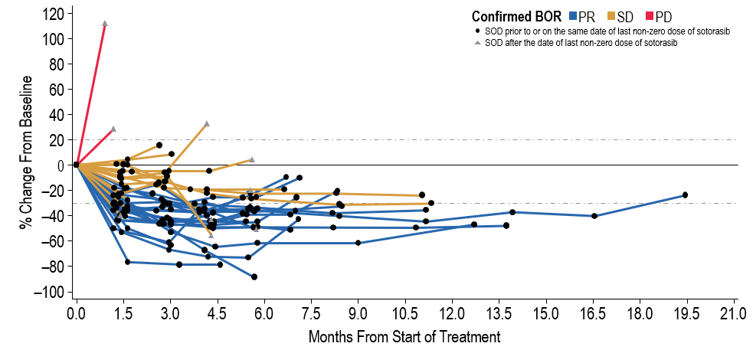
Change in Target Lesions Over Time
Median TTR was 1.6 months (range, 1.2–4.1 months) and median DOR was 7.0 months (95% CI: 5.5, 11.1)
With median follow-up time for OS of 7.9 months, PFS and OS are not yet mature with 21 patients continuing treatment at data cutoff
Data cutoff, 13 April 2023
BOR, best overall response; DOR duration of response; OS, overall survival; PD, progressive disease; PFS, progression-free survival; PR, partial response; SD, stable disease; TTR, time to response
Hong DS, et al. Poster presented at: American Society of Clinical Oncology; June 2–6, 2023; Chicago, IL. Poster #3513

Slide 11
Conclusions
Sotorasib 960 mg PO daily, panitumumab 6 mg/kg IV Q2W, and FOLFIRI IV Q2W was declared the RP2D with no DLTs observed during dose exploration
Sotorasib plus panitumumab and FOLFIRI demonstrated a manageable safety profile with AEs consistent with those expected for the therapies under study
No clinically meaningful sotorasib and irinotecan PK interaction observed
Confirmed ORR was 55% and DCR was 93%, with responses observed regardless of number of prior lines of therapy and progression on prior irinotecan-based therapy
The combination of sotorasib plus panitumumab and FOLFIRI demonstrates promising response rates in pre-treated KRAS G12C mutated mCRC patients, regardless of prior irinotecan and 5-FU exposure
5-FU, fluorouracil; DLT, dose-limiting toxicity; DOR, duration of response; IV, intravenous; RP2D, recommended phase 2 dose; ORR, objective response rate; DCR, disease control rate, PK, pharmacokinetics; orally; Q2W, every 2 weeks
Hong DS, et al. Poster presented at: American Society of Clinical Oncology; June 2–6, 2023; Chicago, IL. Poster #3513

